Slide 1




Earth Observation for Development
Sustainable Agricultural Production

Slide 2


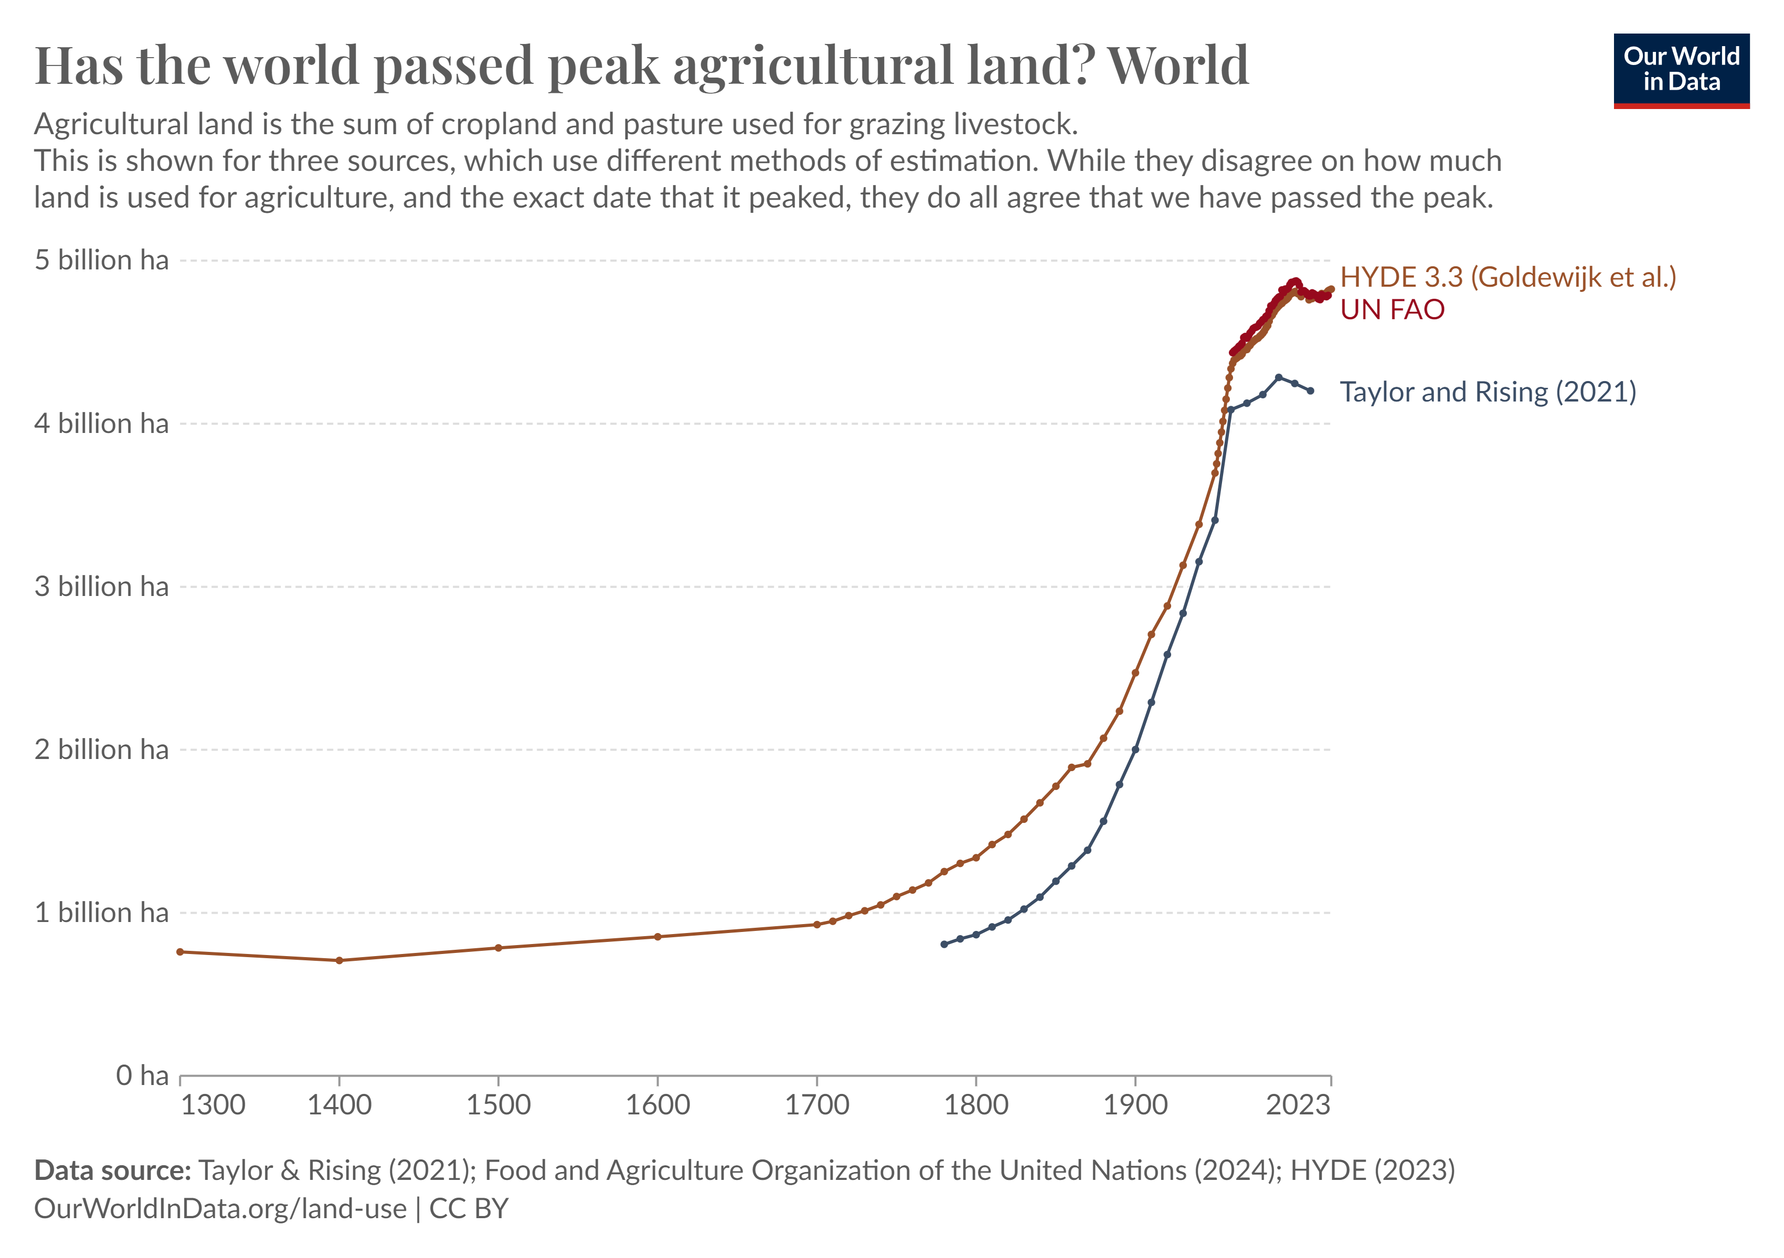
Sustainable Agricultural Production: Introduction
On the global scale, we may have passed the peak of agricultural land use, the total of arable land that is used to grow crops, and pasture used to raise livestock. As you can see in the graph below, various sources agree that globally, that we have reached our peak on agricultural land.
Global peak agricultural land. (Source: Our World In Data)

Slide 3
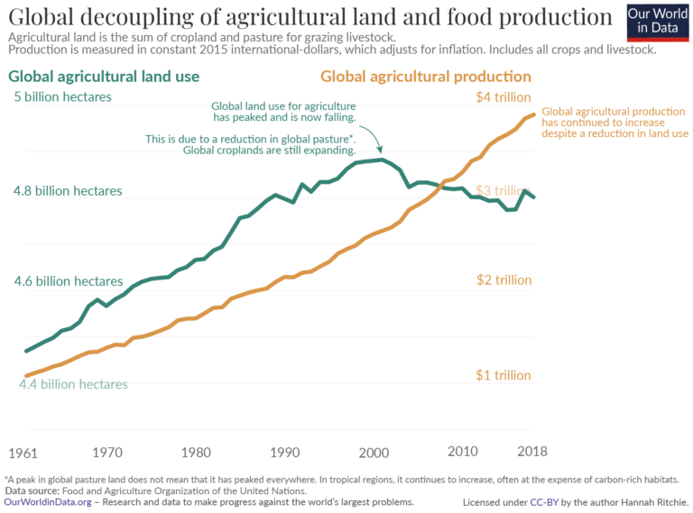
Sustainable Agricultural Production: Introduction
The statistics shown in the graph on the right, shows that we are witnessing a decoupling of food production and land use. Although agricultural land has declined, the world is continuing to grow more food, which is true both for crops and livestock. This means that it is possible to grow more food without taking it away from the environment.
However, the issue is much more complex than that. It plays a role in where food is produced, of which type, and for whom. For example, pasturelands have shifted from arid and temperate to tropical regions, which are much richer in biodiversity and carbon. It is also important to note that agricultural land has peaked, but mainly due to shifts in livestock production. Global cropland is still expanding. In addition, how much land is used for agriculture around the world is not uniform.
Global decoupling of agricultural land and food production. (Source: Our World In Data)

Slide 4
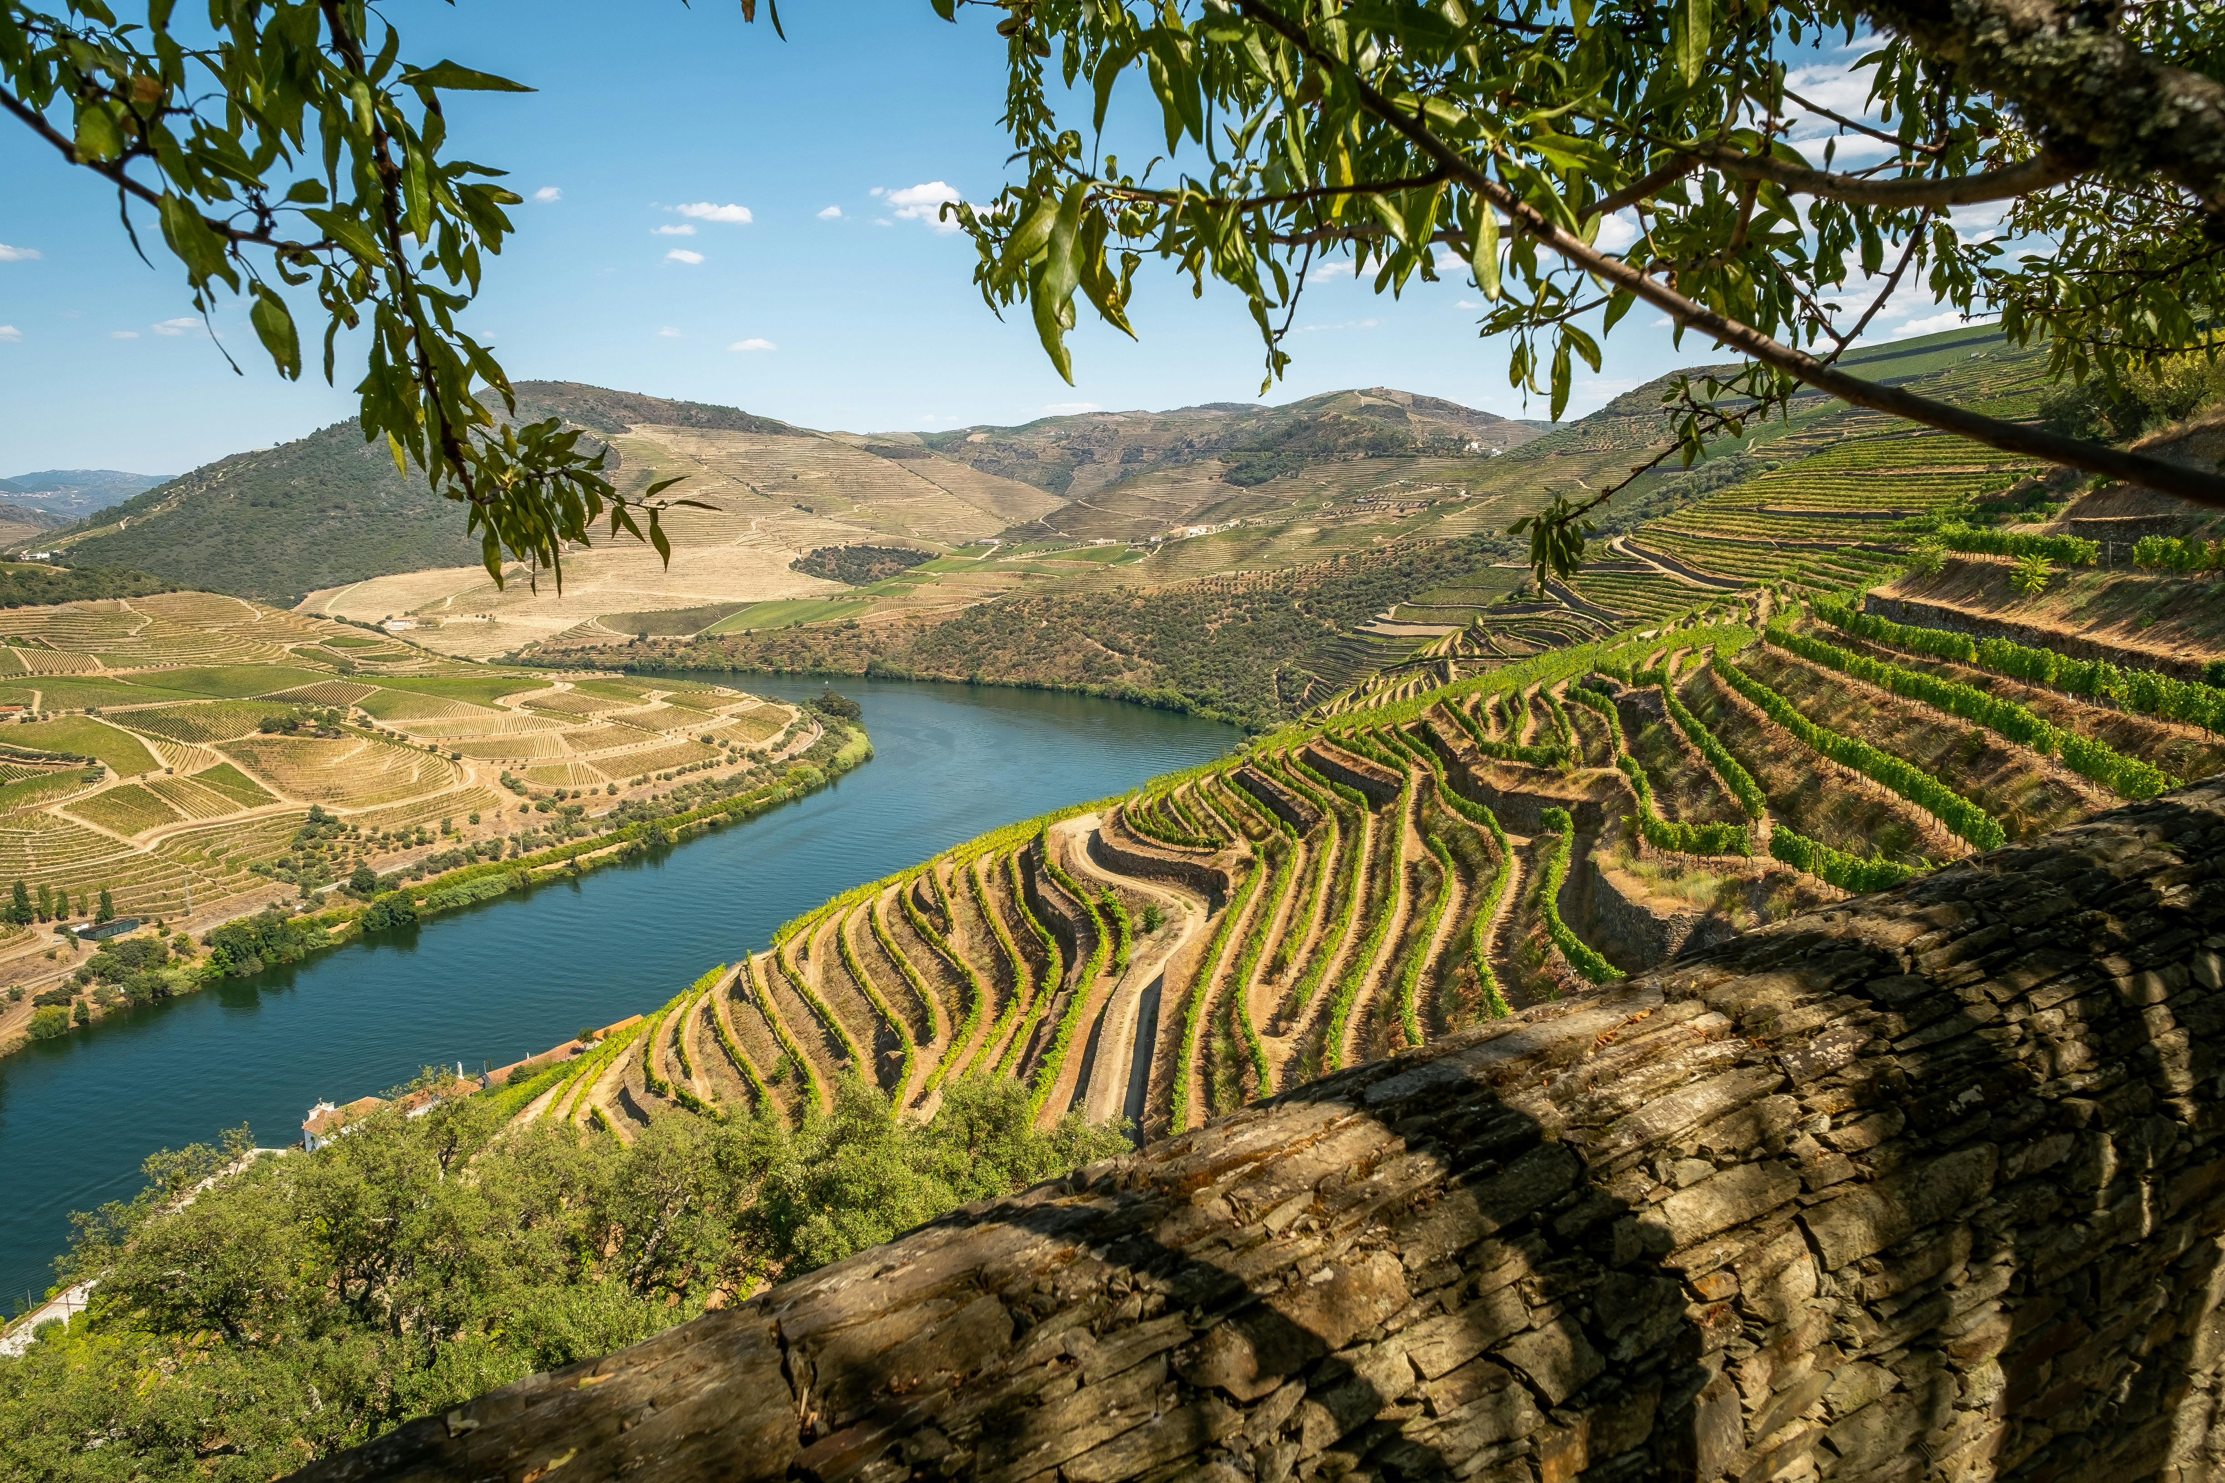
Sustainable Agricultural Production: Sustainable intensification
Sustainable intensification is one of the latest additions to the plethora of approaches, which yields the promise to reconcile increased food production with environmental protection. The concept was brought forward for the first time by Jules Pretty (1997) and centres around techniques that increase yields to cater to the growing population and that provide environmental benefits. Biological techniques include increasing agricultural system diversity through intercropping, agroforestry, or crop-livestock integration, zero tillage farming to reduce soil erosion, precision agriculture for efficient water and nutrient management, integrated pest management, or the use of drought-resistant crops. These can be coupled with intensification techniques such as the use of cover crops, increased crop density, terracing, increased fertiliser efficiency, composting, the use of green manure, or the use of natural enemies to pests.
Image of terraced farming in Spain (Source: Andrew McLeod | Pexels)

Slide 5
Sustainable Agricultural Production: Sustainable intensification
However, both the terms “sustainability” and “intensification” are not clear-cut and highly context-specific. Practices that are sustainable in an ecological way may not be sustainable in an economic one and what is appropriate in one location may not apply in the same way elsewhere. Another criterion is scale. Are we looking at one or more locations, a landscape, a region, or the globe?
Sustainable intensification of agriculture is a promising concept, but also a contested one where the concept is easier conceived than applied. Location-specific information can help uncover interlinkages, synergies, and trade-off effects.
Conventional intensification: Business-as-usual scenario with high inputs and high yields
Sustainable intensification: Resource-saving increase in productivity.

